Slide 1

Child Finder Hackathon ReUNITE - Data Science
Jayashree Narayanan & Bing Hu

Slide 2
Child Finder Hackathon Objective
Input: images and descriptions of active missing children and Cloudera tools.
Output: in the best case, any location information of a child and techniques to search for them manually and in a way that can be automated.
Images and descriptions of active missing children
Child Finder Hackathon Project
Any location information of a child
Discover techniques that can be utilized by NCMEC
Leverage Cloudera technologies and publicly available resources to locate missing children
Provide a path to scale those processes to help automate, escalate and find previously unknown connections between the data
Find ways to speed up the process of to find missing children
Theme:
Big Data
Cloudera tools
Theme:
Data Science
Any techniques to search for them
From <https://childfinder.hackerearth.com/#overview>

Slide 3
Our Prototype Focus
1. Sample analytics from the data collected to offer valuable information to detect patterns to investigate cases/ develop preventative actions and raise awareness.
2. Sample application to demonstrate an Integrated, quick and easy self service search across social media site for missing children by text and image.

Slide 4
Prototype Details – Sample Analytics

Slide 5
Analytics Prototype Approach
1. Sample interactive analytics report integrated into prototype application:
To illustrate that having customized analytical reports integrated into the data gathering application allows users to slice/ dice data based on different constraints.
2. Cloudera Hive data analysis :
Leverage the powerful data analysis capability of the tool to parse/ process data to generate useful indicators for missing children.

Slide 6
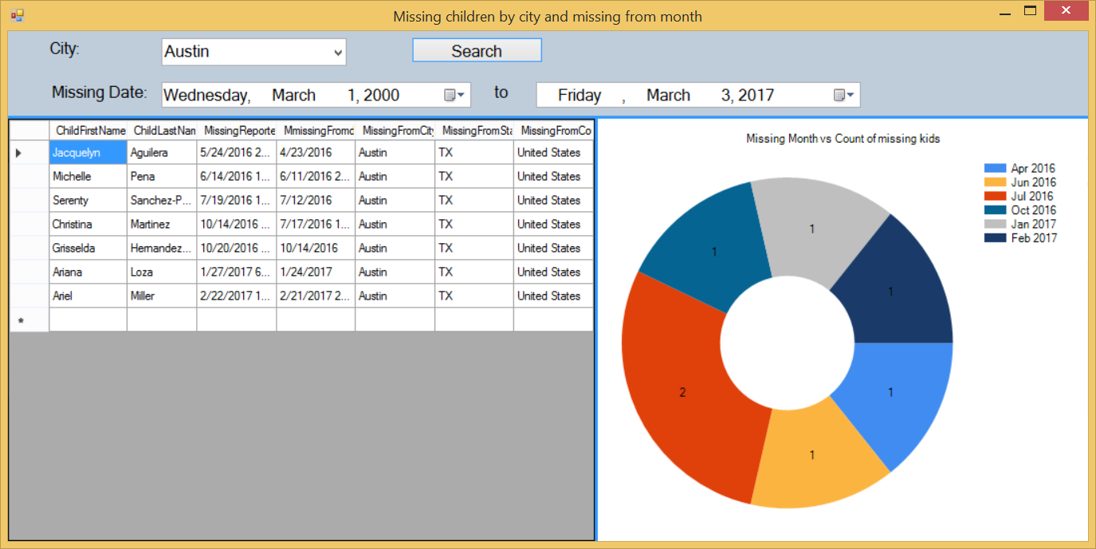
Analytics Prototype – Sample interactive report prototype

Slide 7
Analytics Prototype -- Cloudera HIVE Data Analysis
Child Data
(csv File)
Cloudera
HIVE
Potential Related Factors
Factor | Sample Analysis Case
State | State missing kids total amount
City | Top 10 missing-kids cities
Missing Age | Average Missing Age
Family awareness | Average Family Awareness Factors: missing report date – missing from date
Gender | Gender for 2017 Cases
Race | Race for 2017 Cases
Missing Case Type and Missing City | Missing Case Type and Missing City for 2017 cases
Average Missing Age and Case Type | Average Missing Age and Case Type for 2017 cases

Slide 8
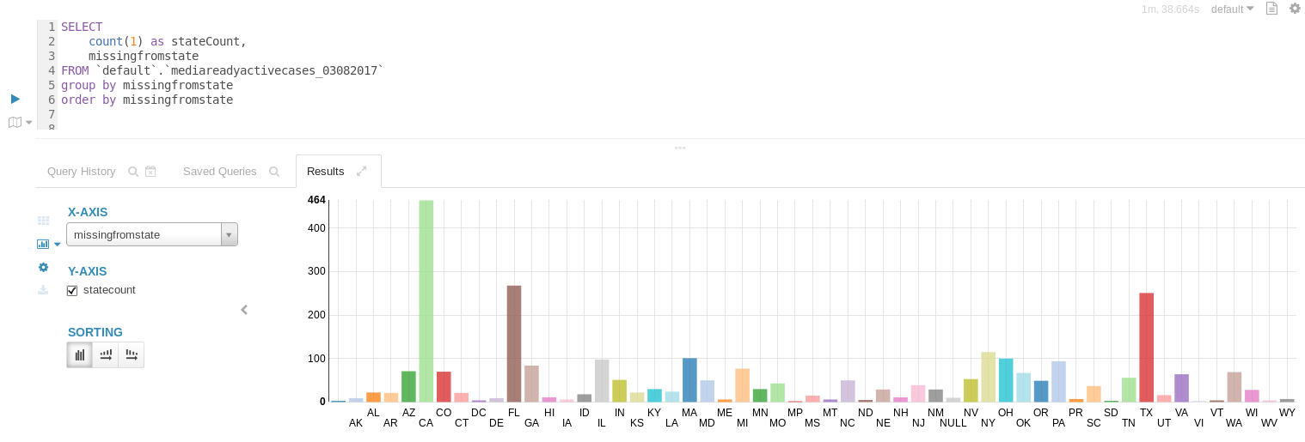
State missing kids total amount

Slide 9
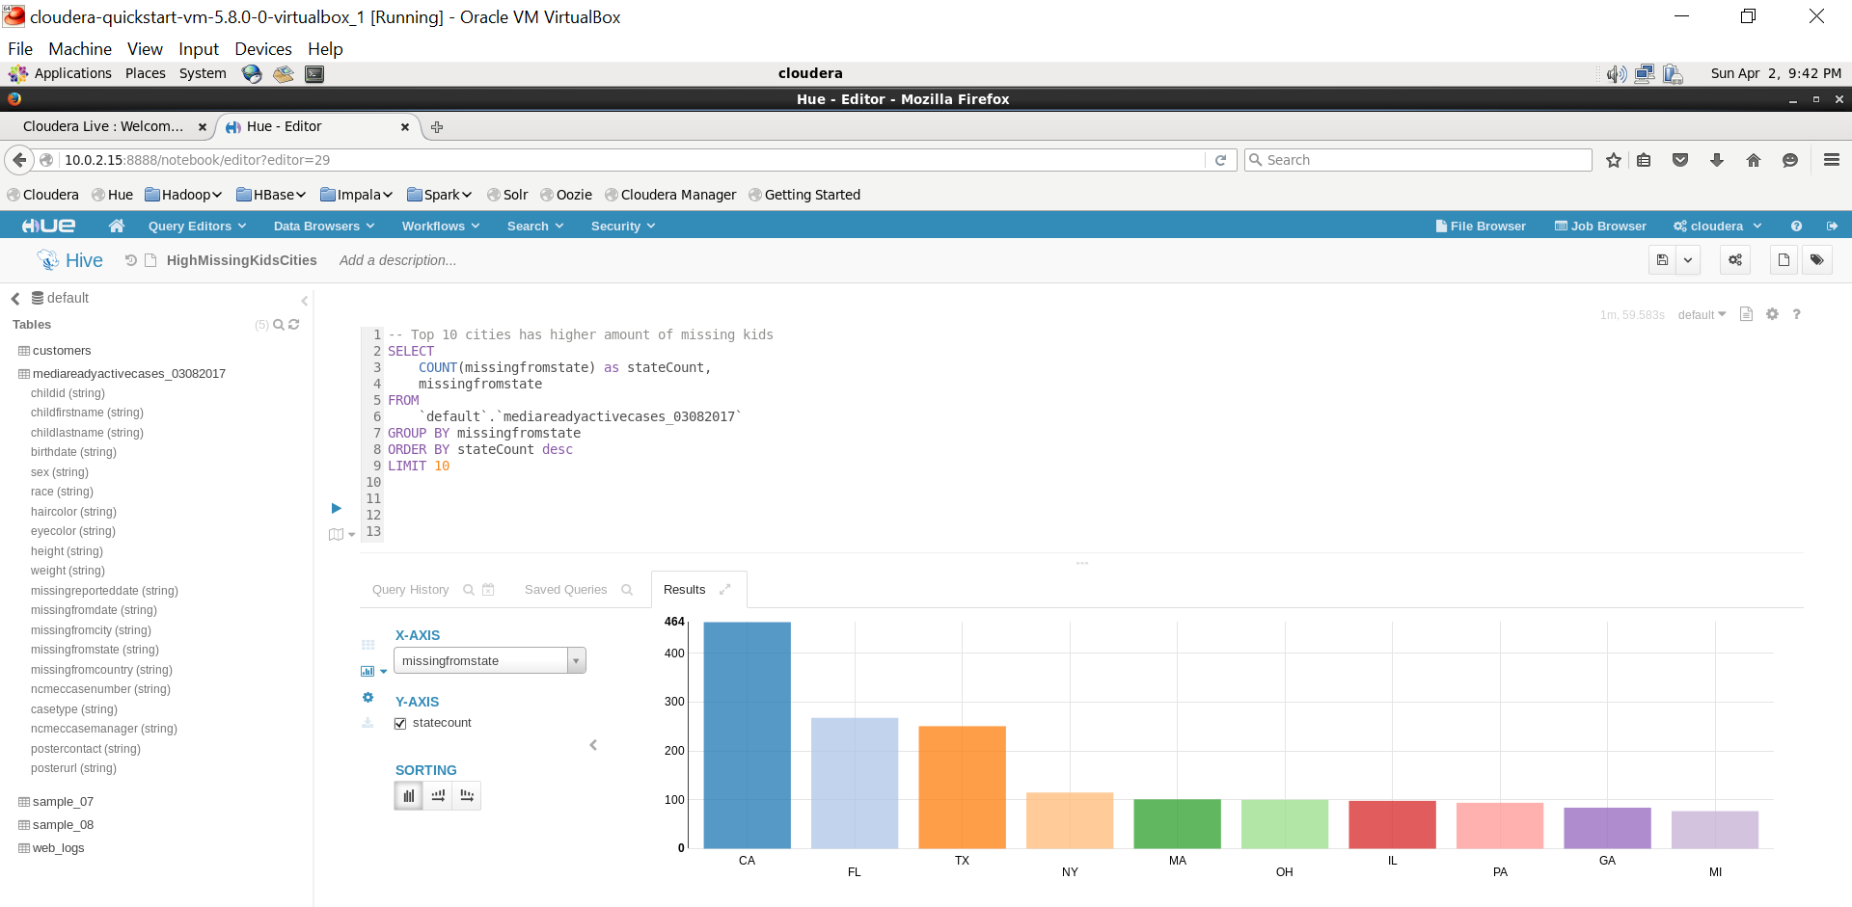
Top 10 missing-kids cities
Potential cities to host
future Child Finder Hackathon

Slide 10
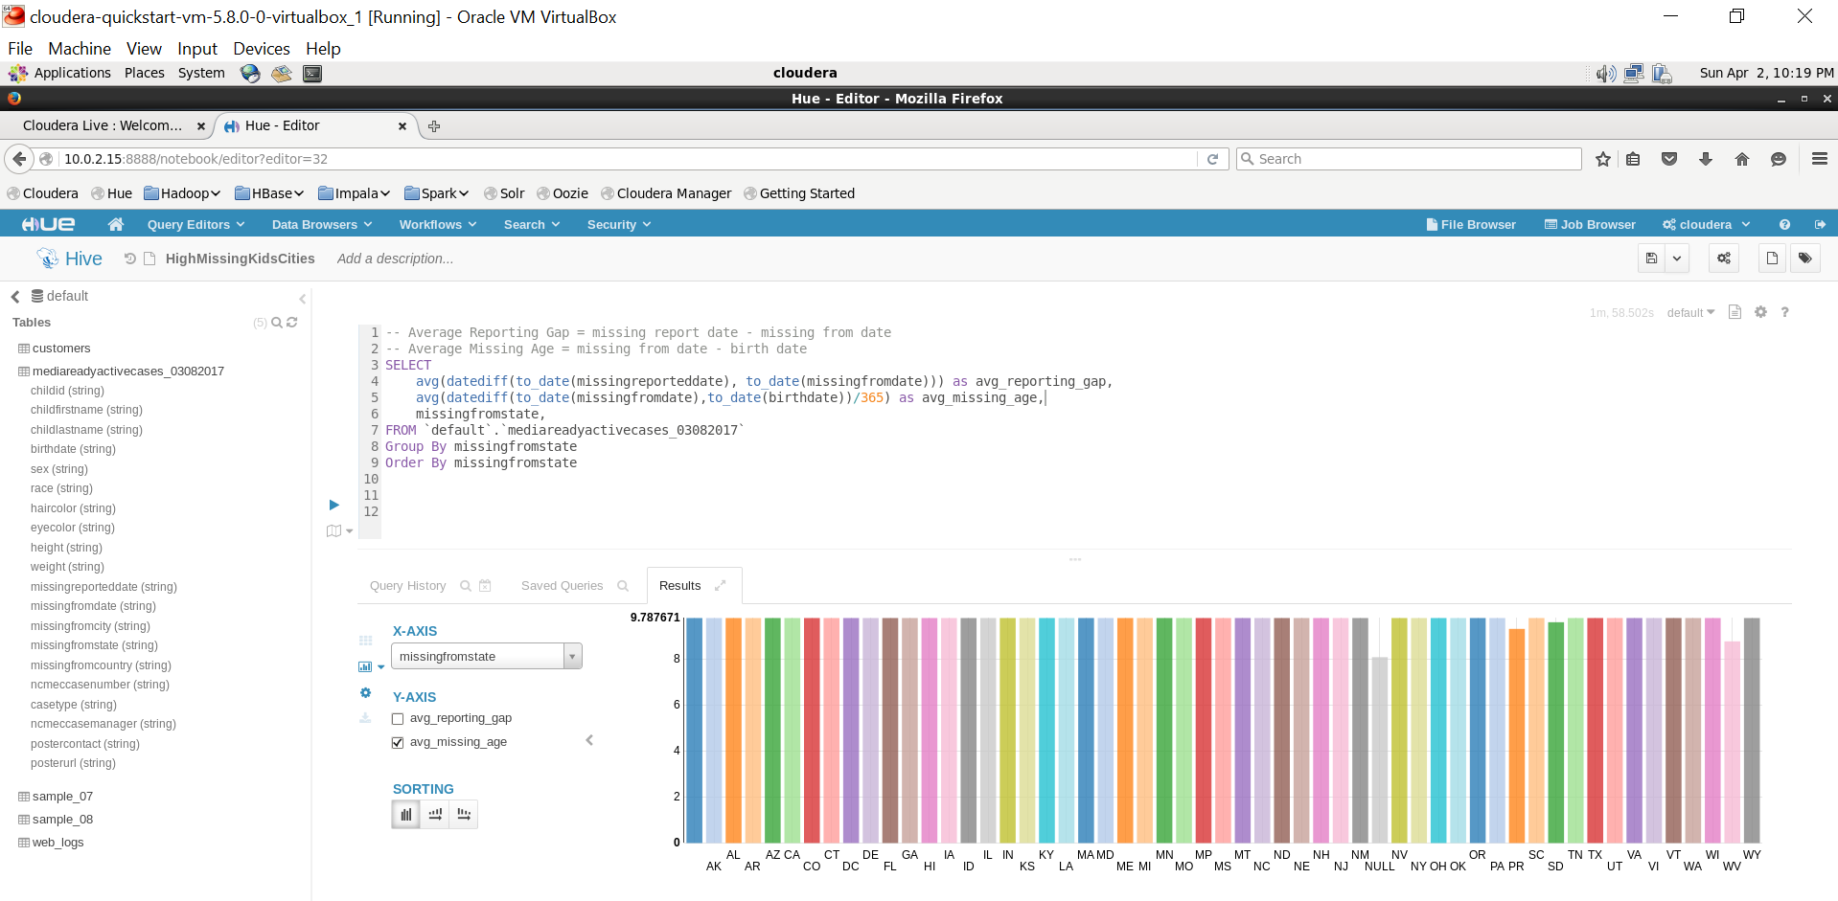
Average Missing Age

Slide 11
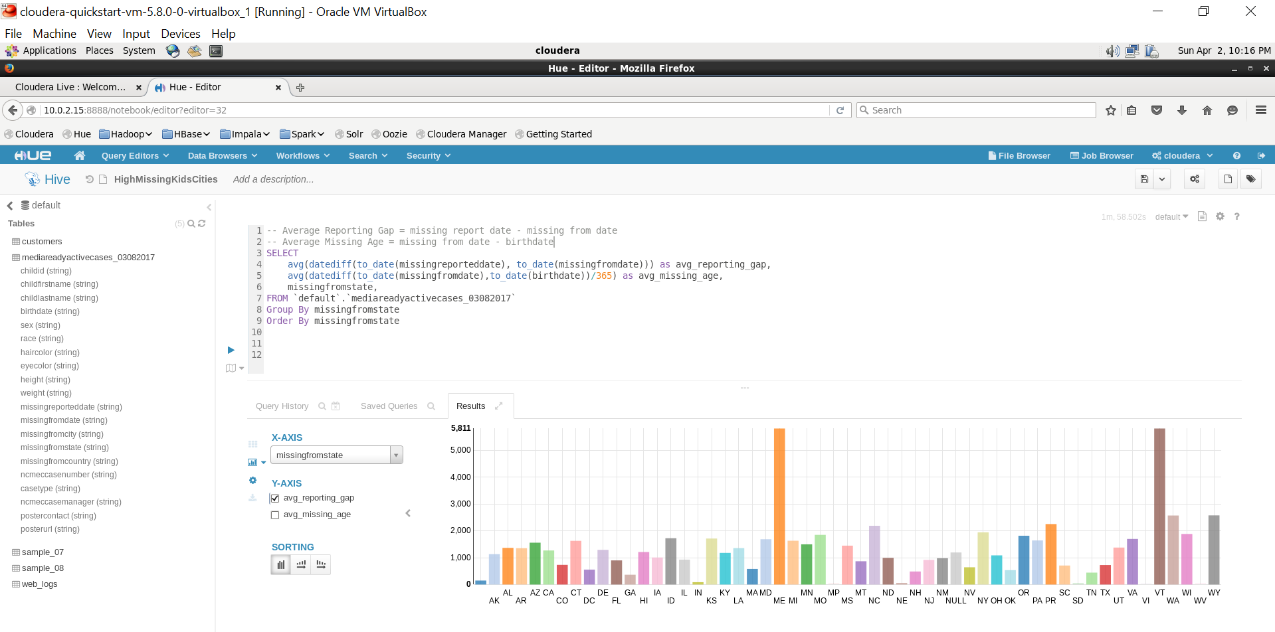
Average Family Awareness Factors: missing report date – missing from date

Slide 12
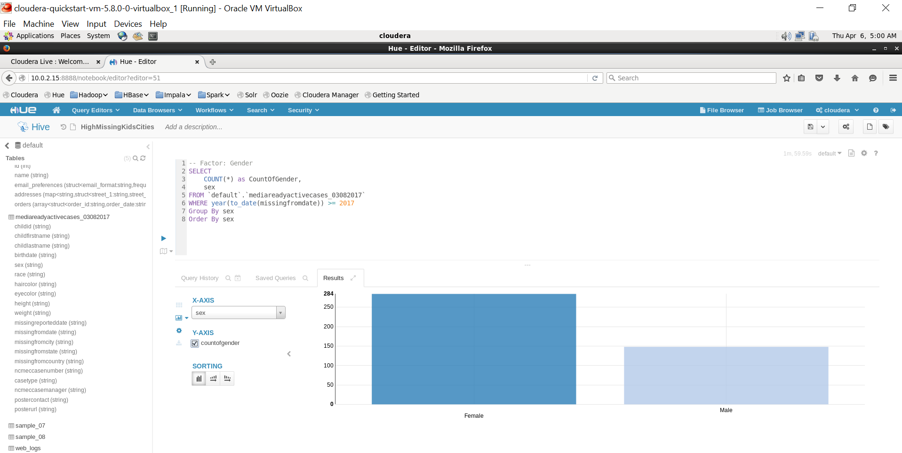
Gender for 2017 Cases

Slide 13
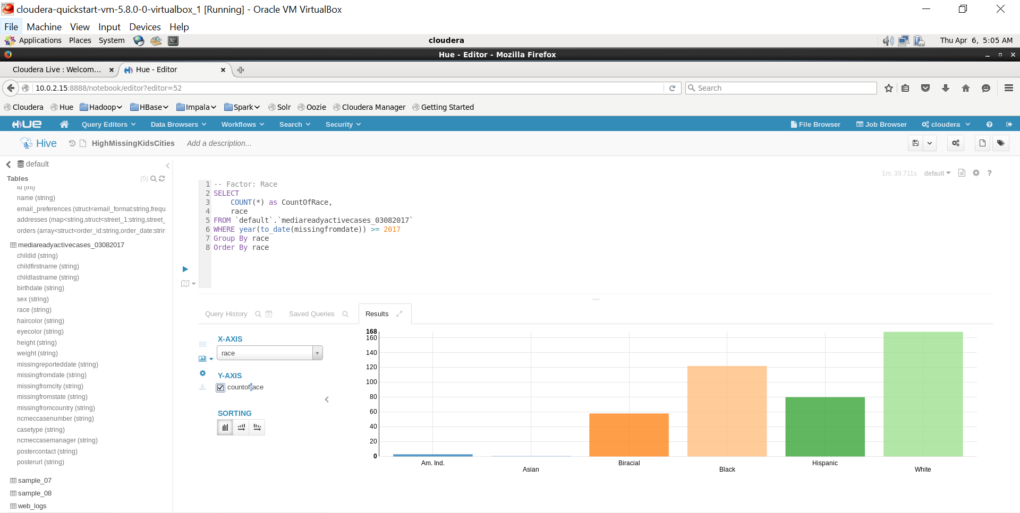
Race for 2017 Cases

Slide 14
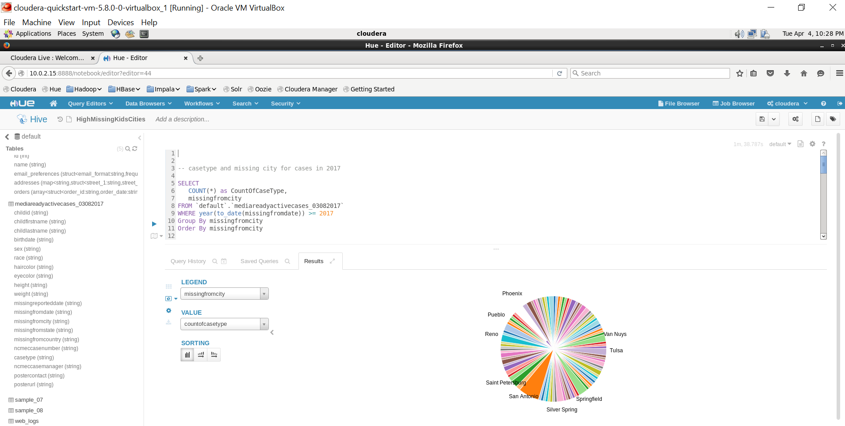
Missing Case Type and Missing City for 2017 Cases

Slide 15
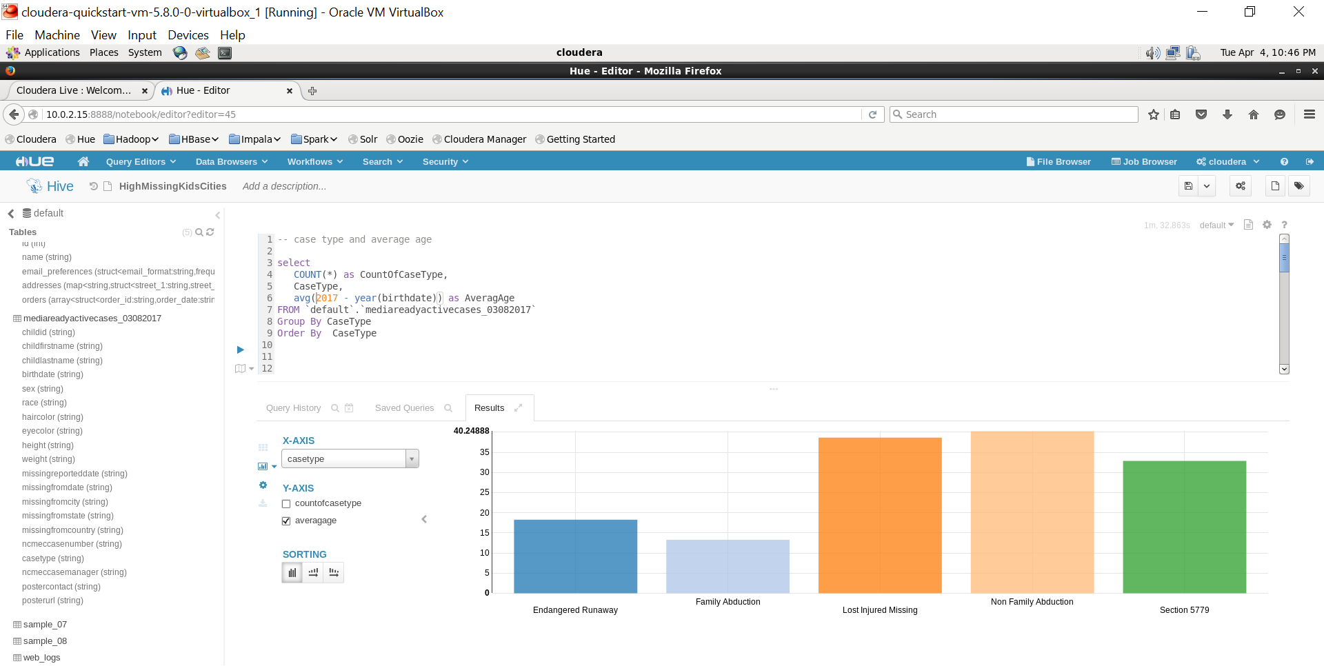
Average Missing Age and Case Type for 2017 Cases

Slide 16
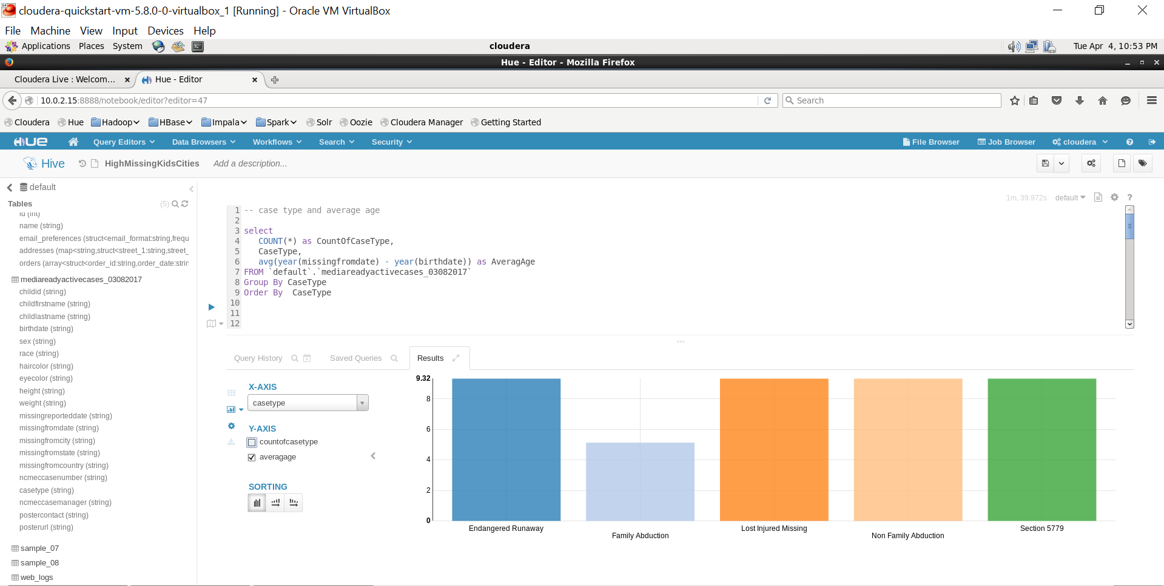
Average Missing Age & Case Type

Slide 17
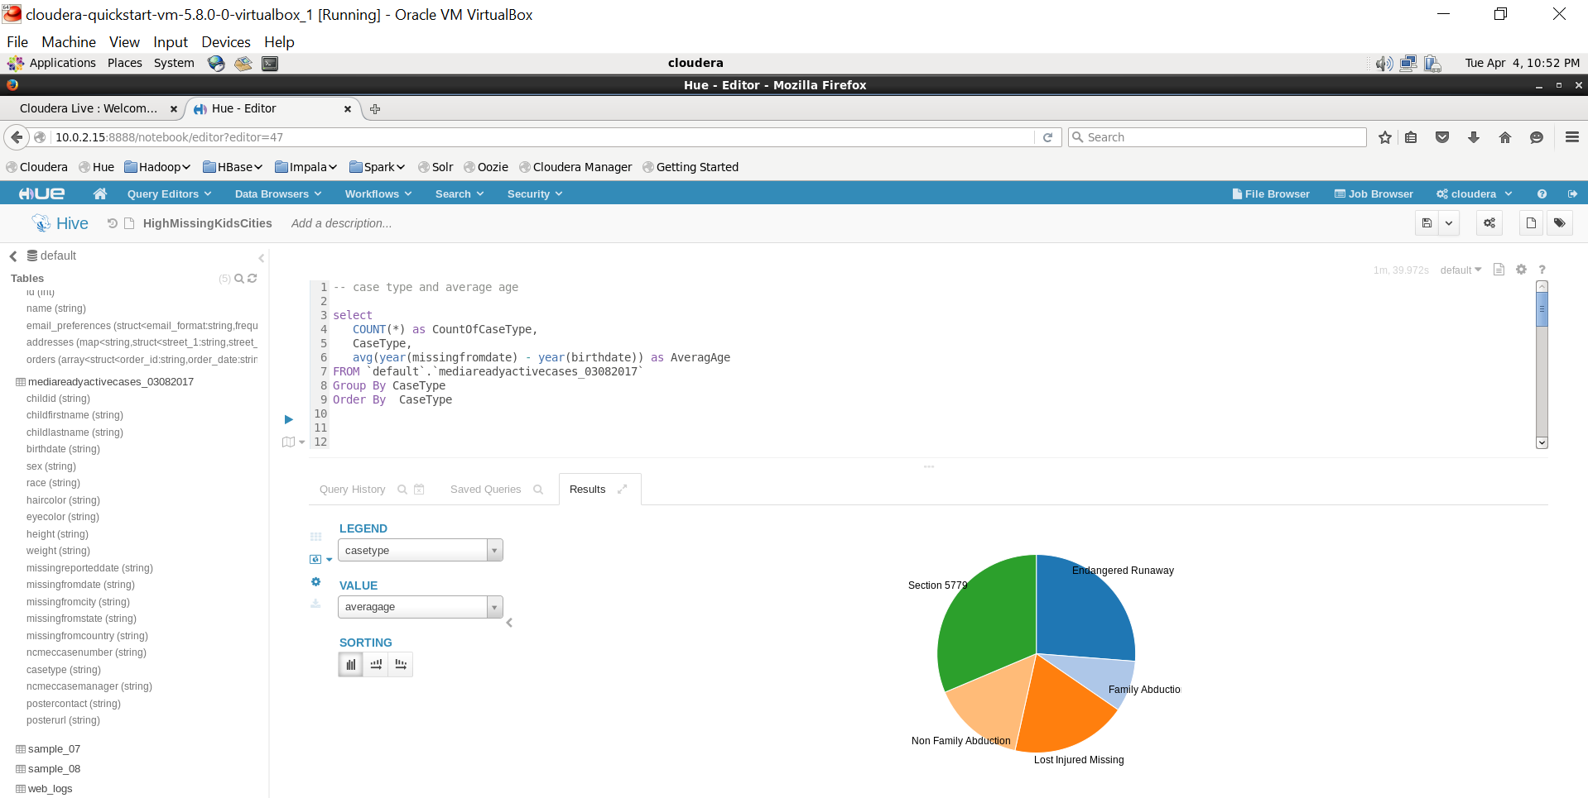
Average Missing Age and Case Type

Slide 18

Prototype Details – ReUNITE Application

Slide 19
ReUNITE Application Install Instructions
1. Unzip the ReUNITE.zip file in a local folder.. Example c:\temp
2. Navigate to c:\temp and launch ReUNITE.exe

Slide 20
Source Code
Prototype code: https://github.com/jnSWPC/ReUNITE

Slide 21
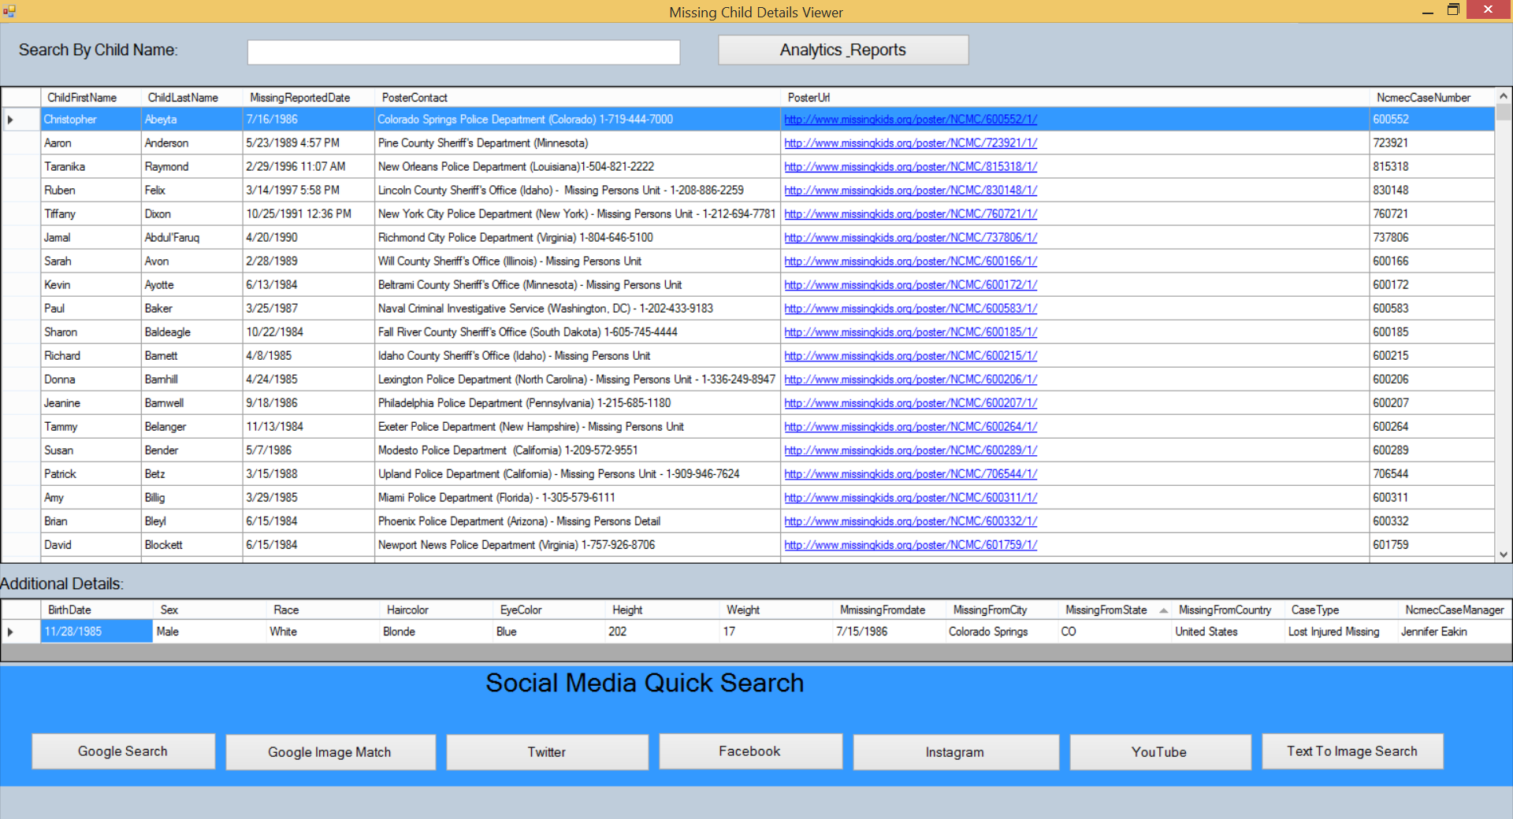
ReUNITE Features
Simple click search for missing children by text/ image across multiple social sites like Google, Twitter, Facebook, Instagram through a consolidated interface.

Slide 22
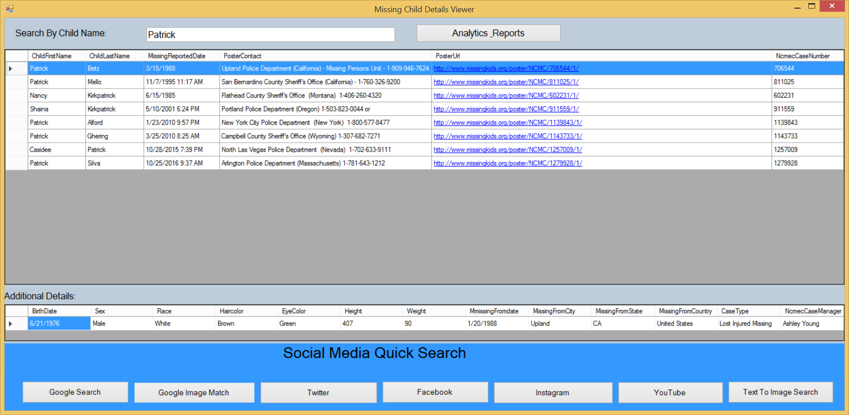
Search Missing Kid by Name

Slide 23
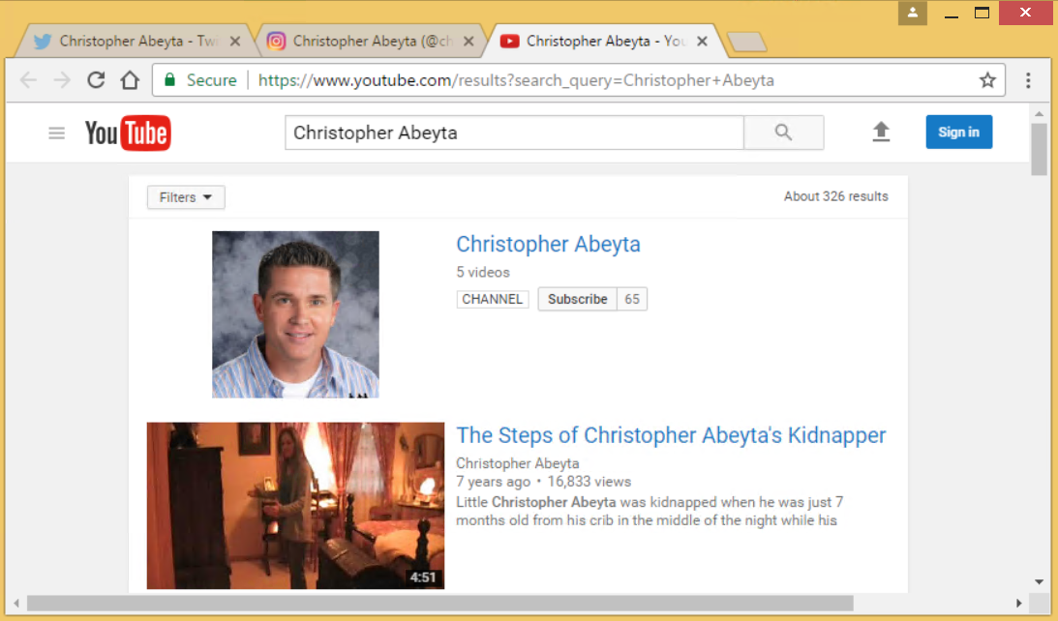
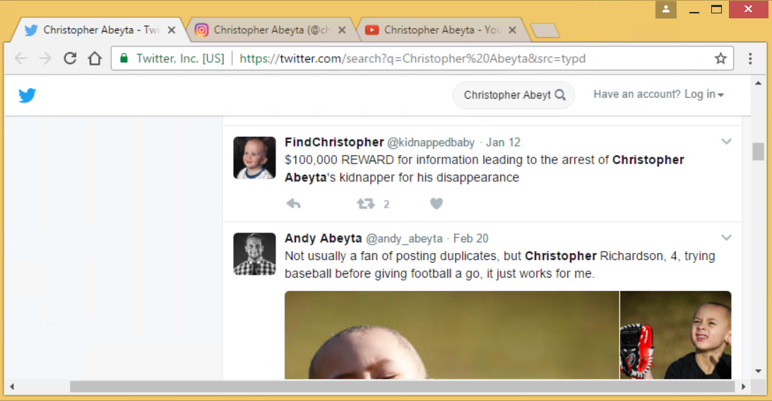
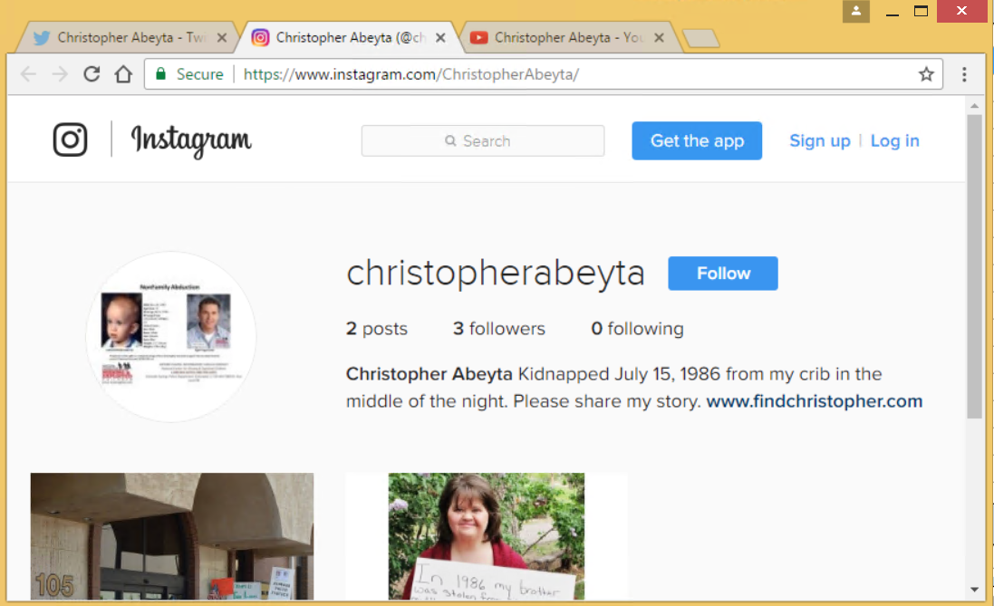
Social Media Quick Search
You Tube
Twitter
Instagram

Slide 24

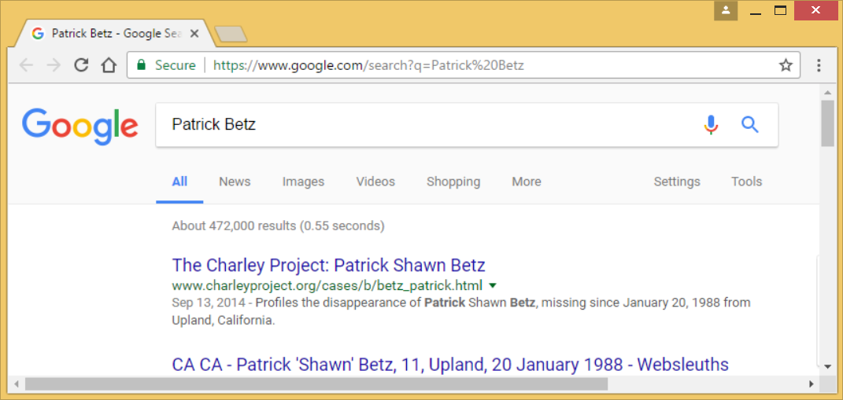
Google Search

Slide 25
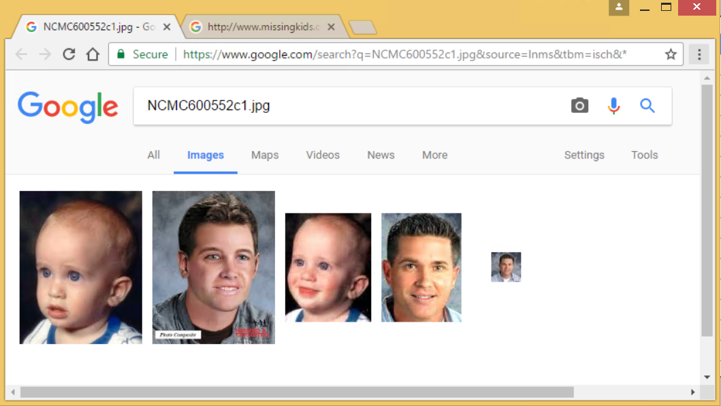
Google Search by Image

Slide 26
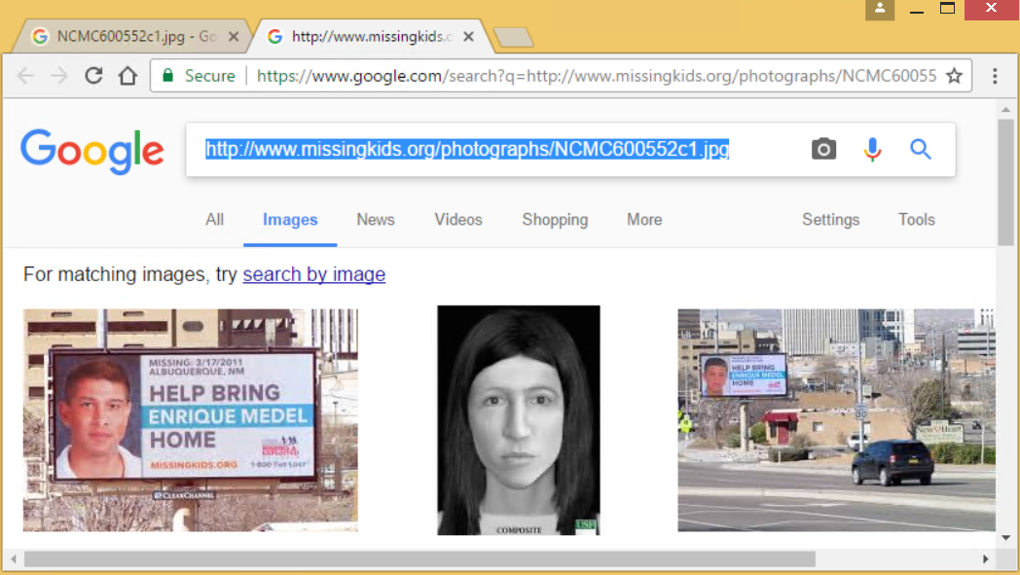
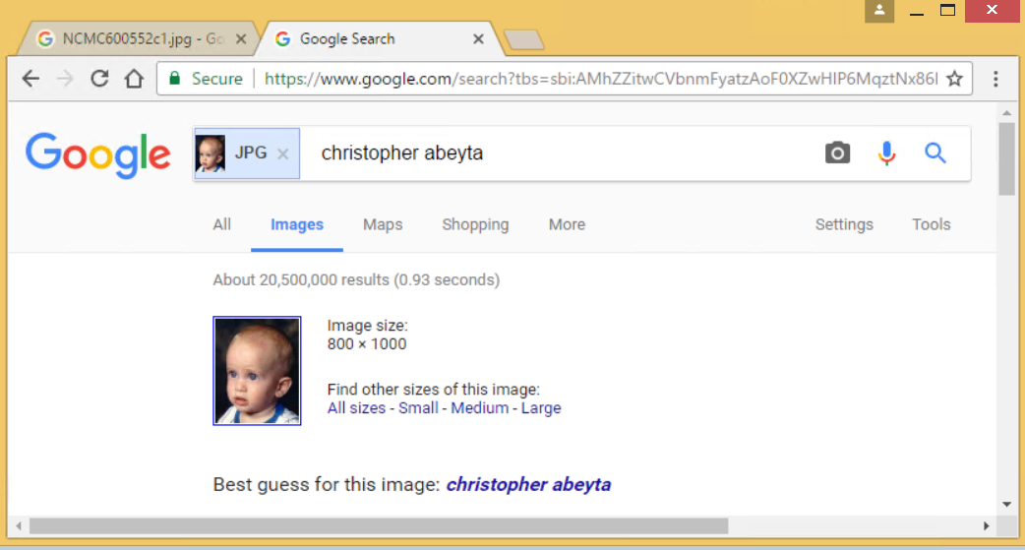
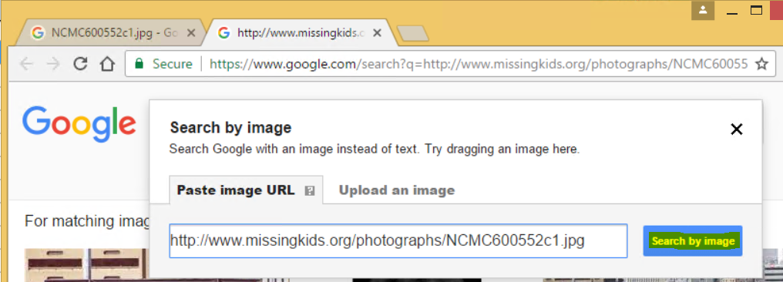
Google Image Match (Manually)
Step 1. Copy image URL to clip-board (Ctrl+C)
Step 3. Click “Search by Image”
Step 2. Click camera icon and paste URL

Slide 27
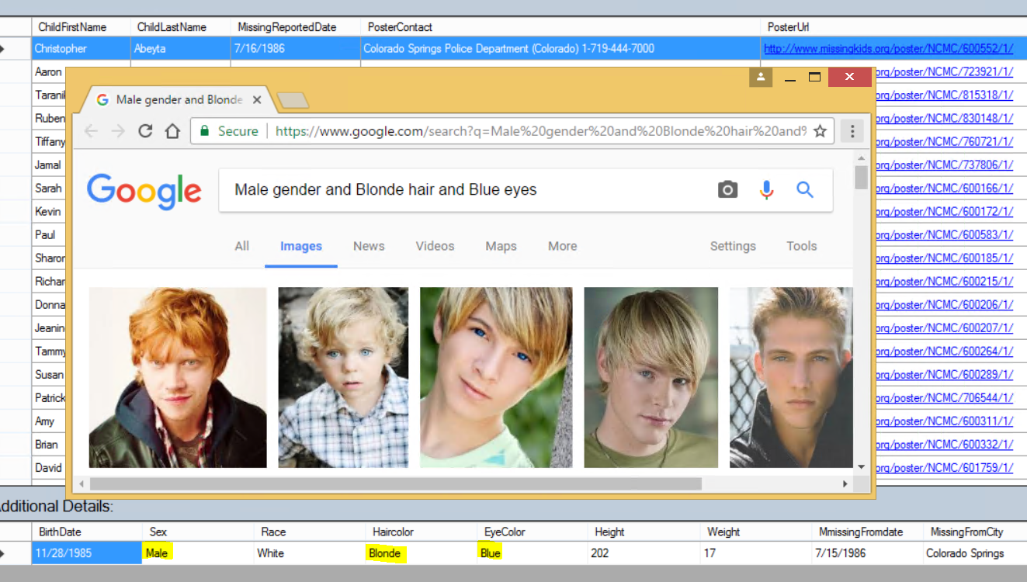
Text to Image Search (Google)
Google image search by using gender, hair color and eye color as search terms.

Slide 28
ReUNITE Extension Opportunity

Slide 29
Data banks to leverage for improving success rate of finding missing children(not implemented in ReUNITE)
Data Mining (*):
Web Cams:
Connect to city traffic web cams/ public camera feeds (airport, subway) and do automated image searches.
Image search can be also be done by typing a collection of key words.
Searching against data banks
Child DNA bank
Doctor office e-Records on immunization records
Biometrics - retina and iris identification (immigration services)
Finger print
Police records
Automated notification sent to checkpoints between state borders
(Refer slide 9 for proposed system design)
*Assumption: NCMEC can gain legal access to the data

Slide 30
Additional Ideas for Optimizing/accelerating search (System Design Prototype: Cloudera + Social Media Mining)
Government BIO Data Banks
Government Public Process
Social Media Public Data Sets
Twitter; Facebook; Google+; …..
ReUNITE Child Finder
Cloudera
FLUME
Cloudera
Public Data Hub
Web Cams;
Public Traffic Intersection Videos; ……
Combine with Social Media to get search key words, child images, and other information
Automated notification
Local News Channels; ……
Cloudera
Hive or Impala
Cloudera
HDFS
Child Data
(csv File)
Fast Search
Any related locations, persons
Cloudera
Oozie
Automate
Shaping Data
Process for query files
Cloudera
Spark or Solr
SMART Search
Reference: <https://www.Youtube.Com/watch?V=yths2c4r7r4>

Slide 31
Suggestions & Ideas

Slide 32
Existing NCMEC Website Improvement Opportunities
There are a few sites offering limited/ focused search capability across social media sites.. They are disconnected systems resulting in potential duplication of efforts/ data and may not be widely publicized. Integrating easy self service search across social media site into the NCMEC website http://www.Missingkids.Com/home can make it a “one stop shop” for its user base( parents/ legal guardians/ organization employees) to report, track, publish, trace, and find missing children.
Also integrating with government organization systems/ public data banks to do proactive automated/ scheduled search and setting up alerts when there are potential hits will be beneficial.

Slide 33
Futuristic ideas to decrease missing children cases
Implant transmitter subcutaneously into the child's body. This will be activated based on unique code.. Upon activation the child can be tracked via GPS
Human safe data dots applied behind child’s ear/ nail.. This will contain identification details of child. Can be seen viewed via ultraviolet light

Slide 34
References

Slide 35
Literature Review
Cloudera/cdh-twitter-example
From <https://github.Com/cloudera/cdh-twitter-example>
Big data & hadoop applications in social media
From <https://www.Slideshare.Net/skillspeed/big-data-hadoop-applications-in-social-media>

Slide 36
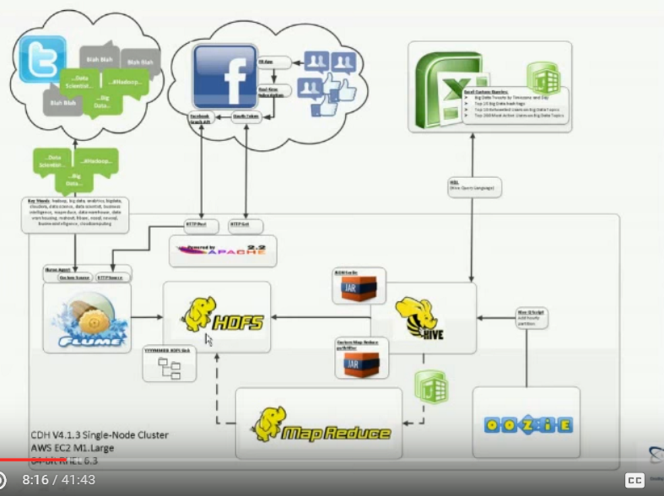
Literature Review
Big data, hadoop, and social media in action
From <https://www.Youtube.Com/watch?V=yths2c4r7r4>

